Slide 1

Seminar
On
Phishing
Attack
Presented By:
Sai Pavan Baki

Slide 2
Contents
Introduction
What is Phishing
How does phishing work?
What are the limitations of phishing attacks?
Phishing Examples
Types of Phishing
The different flavor of Phishing attack
How do I protect against phishing attacks?
Causes of Phishing
Effects of Phishing
Conclusion
Reference

Slide 3
Introduction
Phishing is the most powerful and popular attack for
hacking into emails and web accounts.
Cyber criminals use this attack to hack into bank accounts, Facebook accounts and email account of innocent people.
Every year, most of the biggest cyber crime case involve this attack.
So we must know what is Phishing and how to protect your accounts from phishing attack.

Slide 4
What is phishing?
Phishing is the act of fooling a computer user into submitting personal information by creating a counterfeit it website that looks like a real (and trusted)site.
It is a hacker technique of "fishing" for passwords and other secret financial info.

Slide 5
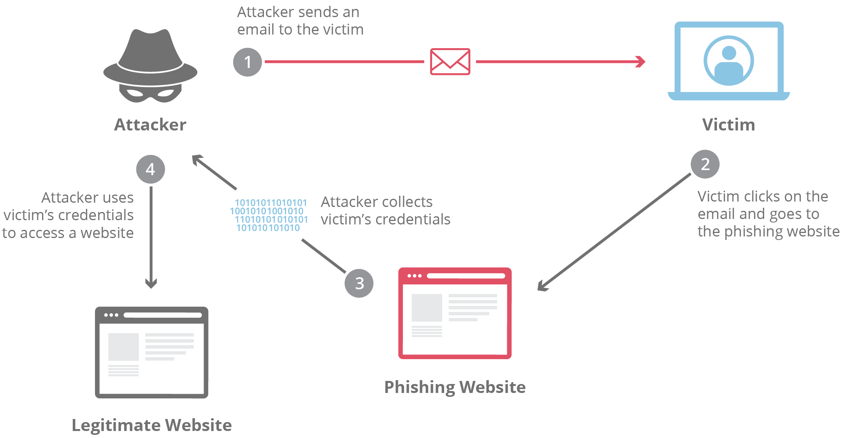
How does phishing work?

Slide 6
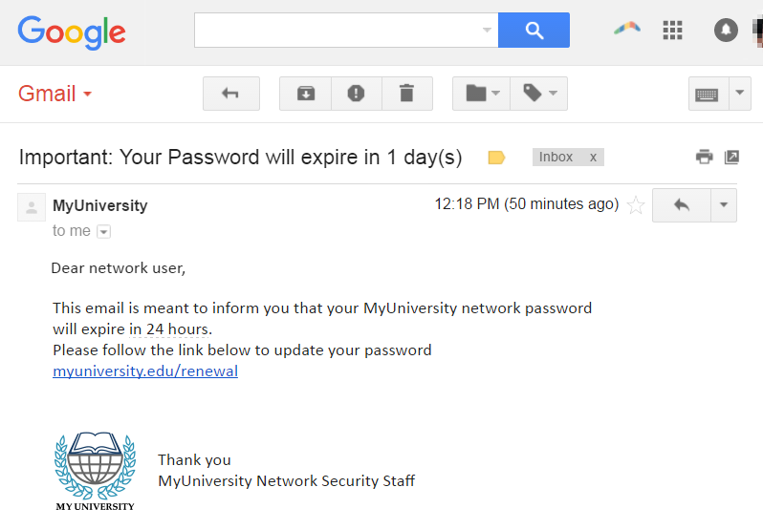
Phishing Examples

Slide 7
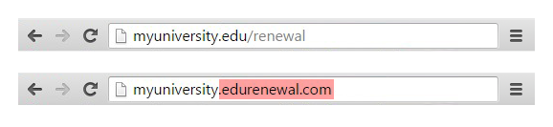
Phishing Examples

Slide 8
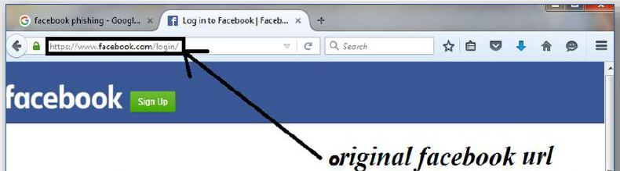
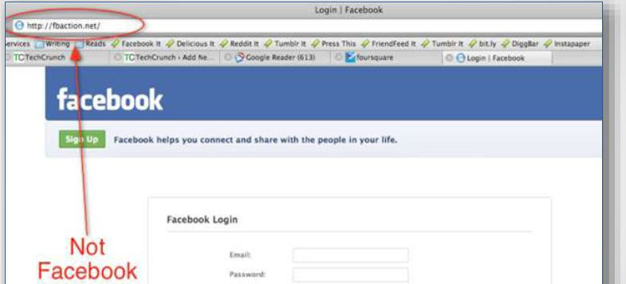
Phishing Examples

Slide 9
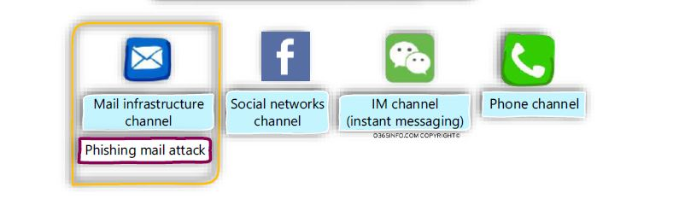
The different flavor of Phishing attack

Slide 10
Types of Phishing:
Deceptive phishing
Spear phishing
Whaling
Pharming

Slide 11
Types of Phishing
Deceptive phishing:
Sending a deceptive email, in bulk, with a “call to action” that demands the recipient click on a link.
In this case, an attacker attempts to obtain confidential information from the victims.
Attackers use the information to steal money or to launch other attacks.
E.g A fake email from a bank asking you to click a link and verify your account details.

Slide 12
Types of Phishing
2. Spear phishing:
Spear phishing targets specific individuals instead of a wide group of people.
Attackers often research their victims on social media and other sites.
That way, they can customize their communications and appear more authentic.
Spear phishing is often the first step used to penetrate a company’s defenses and carry out a targeted attack.

Slide 13
Types of Phishing
3.Whaling:
When attackers go after a “big fish” like a CEO, it’s called whaling.
These attackers often spend considerable time profiling the target to find the opportune moment and means of stealing login credentials.
Whaling is of particular concern because high-level executives are able to access a great deal of company information.

Slide 14
Types of Phishing
4.Pharming
Similar to phishing, pharming sends users to a fraudulent website that appears to be legitimate.
However, in this case, victims do not even have to click a malicious link to be taken to the bogus site.
Attackers can infect either the user’s computer or the website’s DNS server and redirect the user to a fake site even if the correct URL is typed in.

Slide 15
What are THE LIMITATIONS of phishing attacks?
Sometimes attackers are satisfied with getting a victim’s credit card information or other personal data for financial gain.
Other times, phishing emails are sent to obtain employee login information or other details for use in an advanced attack against a specific company.

Slide 16
How do I protect against phishing attacks?
1.User education
One way to protect your organization from phishing is user education.
Education should involve all employees.
High-level executives are often a target Teach them how to recognize a phishing email and what to do when they receive one.
Simulation exercises are also key for assessing how your employees react to a staged phishing attack.

Slide 17
2.Security technology
No single cyber security technology can prevent phishing attacks.
Instead, organizations must take a layered approach to reduce the number of attacks and lessen their impact when they do occur.
Network security technologies that should be implemented include email and web security, malware protection, user behavior monitoring, and access control.

Slide 18
Causes of Phishing
Misleading e-mails
No check of source address
Vulnerability in browsers
No strong authentication at websites of banks and financial institutions
Limited use of digital signatures
Non-availability of secure desktop tools
Lack of user awareness
Vulnerability in applications

Slide 19
Effects of Phishing
Internet fraud
Identity theft
Financial loss to the original institutions
Difficulties in Law Enforcement Investigations
Erosion of Public Trust in the Internet.

Slide 20
Conclusion
No single technology will completely stop phishing.
However, a combination of good organization and practice, proper application of current technologies, and improvements in security technology has the potential to drastically reduce the prevalence of phishing and the losses suffered from it.

Slide 21
Reference
www.google.com
www.wikipedia.com

Slide 22


